Slide 1
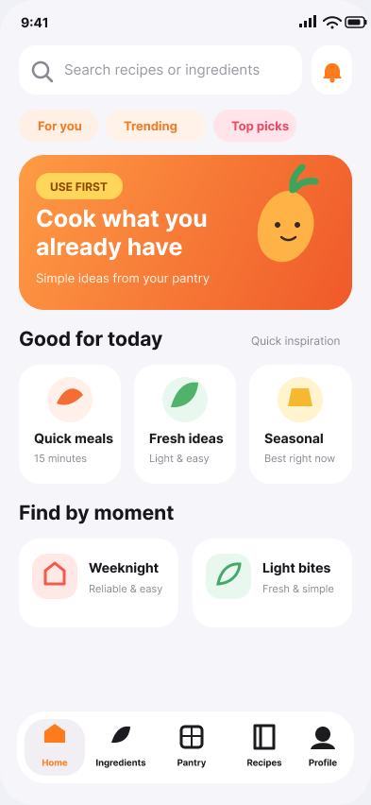
INDUSTRY MENTOR PROPOSAL
KitchMemo
Problem Statement
Australian young adults aged between 18 and 35 who do the grocery shopping often find it hard to identify the food which is already at home. Besides, the changing meals planning, poor visibility of remaining food and uncertainty of leftovers also lead to the edible food being forgotten or thrown away.
An inventory-aware food decision assistant for young Australian households.
CAPTURE
PRIORITISE
COOK
WASTE LESS
Gress
Haoxuan Sun MBIS Max Wu MIT
Chang Lei MCS Yang Qiao MDS
Jingduo Zhang MIT
01

Slide 2
THE PROBLEM IS REAL
02
Australia’s food waste problem starts at home
7.6M
2.5M tonnes
UNDER 35
113 kg
comes from households
tonnes of food wasted every year
≈3%
food wasted per year
of Australia’s GHG emissions
$1,500
≈71% more than older households
SDG 13
CLIMATE ACTION
FOOD
ENERGY
WASTE
13.3 · awareness that becomes action
Production, land, water
→
Cold chain + cooking
→
Disposal + methane
KitchMemo makes the lower-waste choice visible when users cook and shop.
Sources: DCCEEW (2025); OzHarvest Half Eaten (2025, n=3,005); UN SDG 13.3
2

Slide 3
WHY IT HAPPENS + WHO WE SERVE
03
The gap is everyday visibility—not good intentions
Households waste more than twice what they think
SYNTHESISED PERSONA
4.22 kg
actual weekly waste
Jordan, 27
Greater Melbourne · manages groceries and meals
2.03 kg
perceived weekly waste
“I know there is food at home—I just don’t remember what, what to use first, or what I can make.”
The recurring questions
What do I already have?
TIME-POOR
RELIES ON MEMORY
01
LOW TOLERANCE FOR ADMIN
02
What should I use first?
Primary audience: Australian adults 18–34 who independently or jointly manage shopping, storage and meal preparation.
03
What can I cook now?
Sources: End Food Waste Australia, The Great Unwaste;
3

Slide 4
DESIGN RESEARCH
03
Empathy Map and Lotus Blossom converge on the same gap
Target: Greater Melbourne adults 18–34 who manage household shopping, storage and meals
EMPATHY MAP
LOTUS BLOSSOM
What users experience
Where we can intervene
THINK & FEEL
SEE
Digital
inventory
Low-effort
capture
Use First
priority
“What food do I already have?”
Crowded storage · unclear dates
Reminders
USE WHAT
YOU HAVE
Recipe
ideas
SAY & DO
PAIN / GAIN
Rely on memory · improvise meals
Duplicate buys → quick, useful cues
Pre-shop
check
Date + storage
guidance
Household
sharing
PATTERN · EVERYDAY DECISION FRICTION
DESIGN IMPLICATION
Awareness alone is insufficient—reduce friction at the moment of cooking and shopping.
3

Slide 5
OUR SOLUTION
04
KitchMemo turns inventory into the next useful decision
01
02
03
04
05
CAPTURE
REMEMBER
PRIORITISE
ACT
PREVENT
→
→
→
→
What came home?
What is here?
What needs attention?
What can I cook?
What should I not buy?
Barcode · photo · manual
Fridge · freezer · pantry
Date-aware Use First list
Expiry-priority recipes · I2
Pre-shop inventory check
Product principle
Intervene at the moment of cooking and shopping—without pretending to decide whether food is safe.
LOWER FRICTION
Better decisions
4

Slide 6
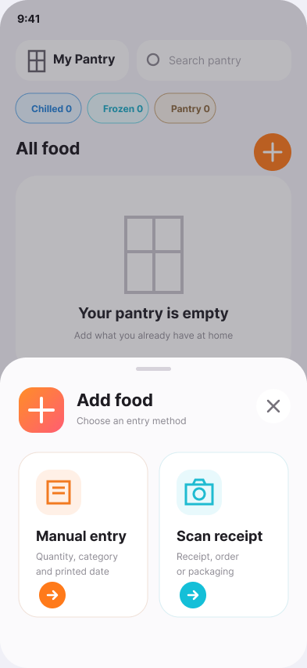
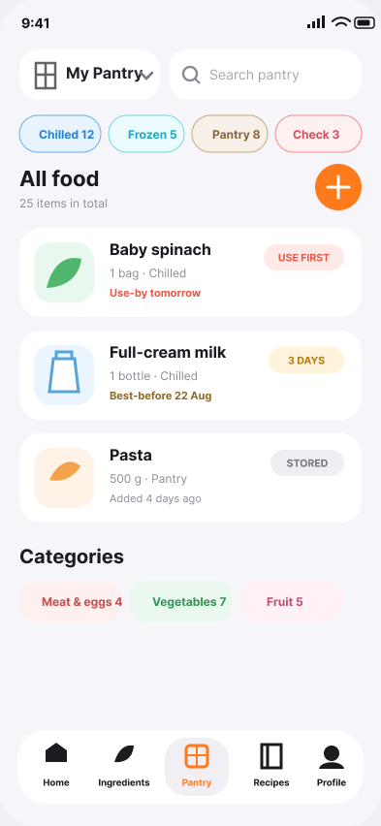
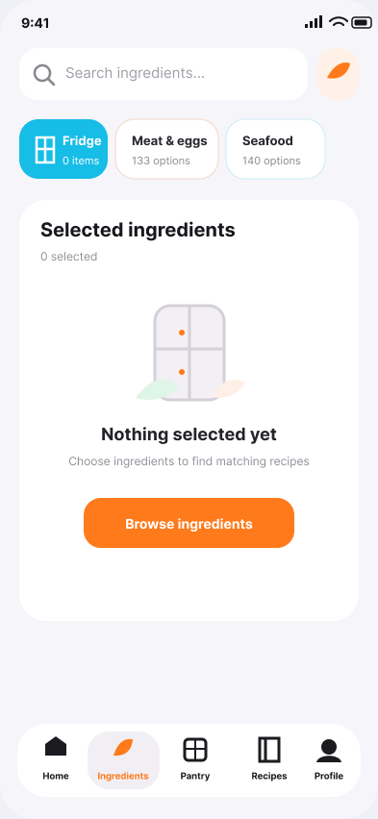
PROTOTYPE WALKTHROUGH
05
Iteration 1 tests whether visibility changes behaviour
→
→
→
1 CAPTURE
2 SEE
3 PRIORITISE
4 ACT
Choose a low-effort entry path
One view across storage locations
Surface food that matters now
Start from ingredients on hand
5

Slide 7
SYSTEM + OPEN DATA
06
A simple architecture keeps AI useful—and accountable
INPUT
KITCHMEMO CLIENT
APPLICATION LAYER
DATA
AI WORKSTREAM
Barcode
Confirm item
Inventory API
Inventory DB
Recipe1M+
→
→
→
→
Photo
Inventory view
Priority rules
Open Food Facts
Offline training
Manual
Use First
User controls
FSANZ guidance
Rank + evaluate
SAFETY GUARDRAIL
I1
Distinguish use-by from best-before. Always require confirmation. Never automate edibility decisions.
Train + evaluate
I2 user-facing
Sources: Open Food Facts API (ODbL); MIT Recipe1M+; FSANZ date marking guidance
6

Slide 8
ITERATIONS 1–3
07
Build the decision loop before scaling the intelligence
ITERATION 1
ITERATION 2
ITERATION 3
Make inventory useful
Turn priority into action
Learn and coordinate
E1 Barcode / photo / manual capture
→
E5 User-triggered expiry-priority recipes
→
E8 Shared household inventory
E2 Inventory + date labels
E6 Storage + date guidance
Personalisation from feedback
E3 Use First + reminders
E7 Pre-shop decision support
Validated behaviour / impact insights
E4 Train recipe model offline
I1 exit evidence
Users complete the loop: add → notice → update → check before shopping; model baseline is reproducible and evaluated.
7

Slide 9
DELIVERY + TOP RISKS
08
Iteration 1 delivers a product proof and an AI proof
PRODUCT TRACK
AI TRACK
End-to-end inventory loop
Reproducible recommendation baseline
Capture → confirm → store → prioritise → update → pre-shop check
Clean public recipe data → train → evaluate ingredient relevance → document limits
Top risks—and the response designed into I1
ENTRY BURDEN
Minimum required fields + smart defaults
SCAN / DATA ERRORS
Mandatory confirmation + manual fallback
RECIPE RELEVANCE
Offline metrics + scenario review before release
DATE / SAFETY CONFUSION
Label-aware language; no edibility decision
Sources: FSANZ date guidance; MIT Recipe1M+;
8
Notes:
For Iteration 1, we need to prove two things.
The first is that the full inventory journey works—from adding and confirming food to updating the inventory and checking it before shopping.
The second is that our recipe model has a reliable starting point. We will clean the public recipe data, train and test the model, and record its limitations before it becomes available to users.
We have four main risks.
First, maintaining the inventory may take too much effort, so we will minimise the required information and make updates simple.
Second, barcode or photo results may be incorrect, so users must confirm the information, and manual entry will always be available.
Third, recipe recommendations may not be useful in real households. We will test them offline and review realistic scenarios before release.
Finally, users may misunderstand date reminders as food-safety advice. KitchMemo will use clear language and will never decide whether food is safe to eat.

Slide 10
POTENTIAL SPONSORS + MENTOR ASK
09
We want partners who can challenge the behaviour—not just the build
Potential partners
OzHarvest
Household behaviour expertise · Use It Up campaign · access to practical education and validation contexts
End Food Waste Australia
National strategy delivery · research + industry network · alignment with halving food waste by 2030
Sources: DCCEEW—End Food Waste Australia; OzHarvest Use It Up
9
Notes:
Finally, we have identified two organisations that could potentially help us test the project in a real-world setting.
The first is OzHarvest. It has strong experience in household food-waste behaviour and runs practical programs such as the Use It Up campaign.
The second is End Food Waste Australia. It supports Australia’s national goal of halving food waste by 2030 and has strong research and industry connections.
At this stage, they are only potential partners. We have not contacted them or confirmed any partnership.
We are not only looking for support with the technology. More importantly, we want partners who can help us test whether KitchMemo actually changes household behaviour.
Thank you. We would really appreciate your feedback.

Slide 11
BACKUP
10
Evidence and data sources
AUSTRALIAN SCALE
LABELS
DCCEEW — Reducing Australia’s food waste (2025)
RMIT + EFWA date-labelling research; FSANZ guidance (2025)
TARGET GROUP
STRATEGY
OzHarvest — Half Eaten: Household Food Waste Research (2025)
National Food Waste Strategy; UN SDG target 12.3
NEWS
OPEN DATA
ABC RN — Australians throw out $1,500 of food each year (2025)
Open Food Facts API (ODbL)
BEHAVIOUR
AI DATA
End Food Waste Australia — The Great Unwaste research
MIT Recipe1M+; UCSD Food.com recipe interactions
10
Notes:
Backup reference index.
[Sources]
- https://www.dcceew.gov.au/environment/protection/waste/food-waste
- https://www.ozharvest.org/news/research-shows-generation-waste-as-millennials-and-gen-z-fuel-the-nations-food-waste-problem/
- https://www.abc.net.au/listen/programs/radionational-breakfast/australians-throw-out-1500-of-food-each-year/105694846
- https://endfoodwaste.com.au/national-consumer-behaviour-change-campaign/
- https://www.rmit.edu.au/news/all-news/2025/jun/date-labels
- https://www.foodstandards.gov.au/consumer/labelling/dates
- https://github.com/openfoodfacts/openfoodfacts-server/blob/main/docs/api/ref/api.yaml
- https://pic2recipe.csail.mit.edu/
- https://cseweb.ucsd.edu/~jmcauley/pdfs/emnlp19c.pdf

